Slide 1
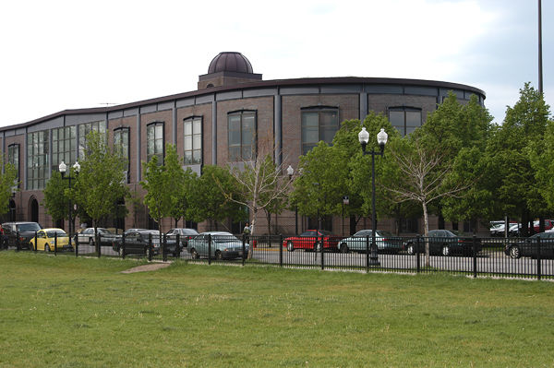
Chicago Public Library
Sulzer Regional Library
Summer Learning Program Presentation by: Latrece Hunter-Singleton, Aimee Norris, Amanda Shively

Slide 2
History of Sulzer
Our Mission Statement
Who Is Conrad Sulzer?
Sulzer Regional Library is Built
Lincoln Square/Ravenswood Neighborhood

Slide 3
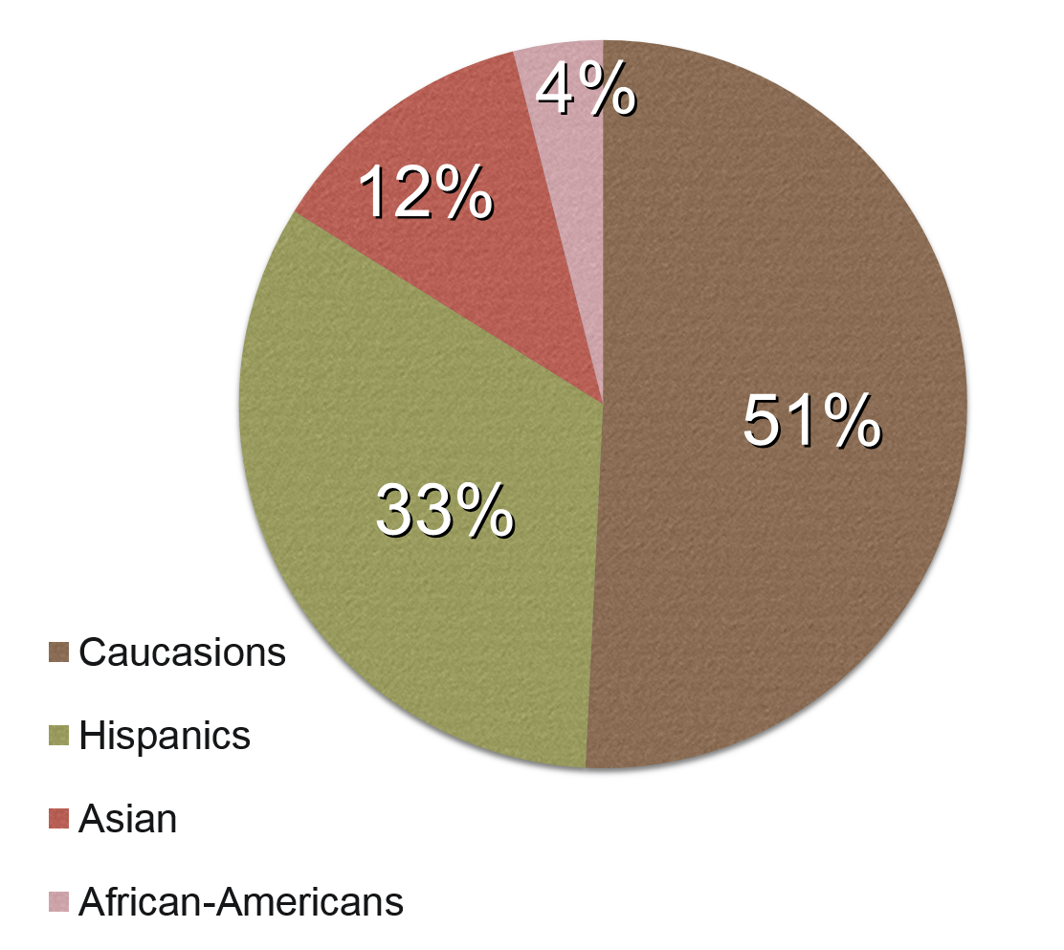
Community Assessment
Demographics
Local Businesses
Schools
Events

Slide 4
Rock Around the World
Summer Learning Program
Program Description: Music and Performance Themed
Collaboration with Old Town School of Folk Music and DANK Haus German American Center
Square Roots Music Festival

Slide 5
Goals and Objectives
Increase amount of reading by participants from last year
New teen-focused program
Culture enrichment through music
STEAM and 21st Century skills as prerogative in programming
Support non-traditional forms of learning
Family and intergenerational activities
Collaboration with local schools and businesses

Slide 6
Children’s Summer Learning Program
READ: 30 minutes a day for 300 minutes total.
OBSERVE: Listen, watch, or experience a new song, performance, or instrument.
DESIGN: Create your own song, dance, performance, or musical instrument.
ACCOMPLISH: Complete 1 Observe, 1 Design, and read 300 minutes to receive a T-shirt and a raffle ticket for Tablet and Speakers!
Example programs and activities.

Slide 7
Teens’ Summer Learning Program
“Summer REMIX”
READ: 30 minutes a day for a total of 500 minutes.
OBSERVE: A new dance, song, performance, or poem and give a detailed report.
DESIGN: Write, draw, create, or perform a new song, remix, dance, poem, or musical instrument.
ACCOMPLISH: Complete 1 Observe, 1 Design, and read 500 minutes to receive a REMIX T-shirt and a raffle for an iPad and Speakers.
Example teen programs.

Slide 8
Final Thoughts
Inputs and Outputs
Staff/Participants/Funding = Free program/Increased participation/Incentives
Teen-focused programs/Incentives/Goals = Higher teen attendance/interest in the library
Focus on STEAM/21st Century Skills = Relevant educational and workplace experience
Any thoughts/questions?

